Slide 1
BESTSELLER
E-Commerce website

Slide 2
Abstract/OBECTIVE
E-commerce (electronic commerce) is the buying and selling of goods and services, or the transmitting of funds or data, over an electronic network, primarily the internet.
These business transactions occur either as business-to-business (B2B), business-to-consumer (B2C), consumer-to-consumer or consumer-to-business.
E-Commerce, also known as electronic commerce or internet commerce, is an activity of buying and selling goods or services over the internet or open networks.
So, any kind of transaction (whether money, funds, or data) is considered as E-commerce.

Slide 3
PROBLEM STATEMENT
E-commerce provides an easy way to sell products to a large customer base. However, there is a lot of competition among multiple e-commerce sites.
When users land on an e-commerce site, they expect to find what they are looking for quickly and easily.
The purpose of any e-commerce website is to help customers narrow down their broad ideas and enable them to finalize the products.
users are not sure about the brands or the actual products they want to purchase. They have a very broad idea about what they want to buy. Many customers nowadays search for their products on Google rather than visiting specific e-commerce sites.

Slide 4
EXISITING SYSTEM
The E-commerce Management System will primarily provide a platform to purchase, sell, distribution of items, product or service through the internet and on some other network.
It will provide an option to a customer for the comparison of product with another seller, while a shop is available only at day time the e-commerce is available 24 hours of a day and seven days of the week.
The E-commerce Management System will be a huge marketplace as most of the business are going to implement based on the internet. This system will provide the detailed description of the products to users so that they can compare to the different product and will by the one which is more suitable to them.

Slide 5
PROPOSED SYSTEM
The E-commerce Management System has many advantages, compare to traditional store as one can compare the cost of a product with other e-commerce websites, and if a user dislikes any product he/she can return it.
While we can make use of the current technology to overcome the problem with the existing system. The E-commerce Management System companies can use a flying robot, so when a user places an order, the company will send the product through the robot. The robot will find the user by using the GPS, and in this way, we can reduce the time to deliver a product.
While before sending a product the e-commerce company will check the product that it is same or not with the requested order.

Slide 6
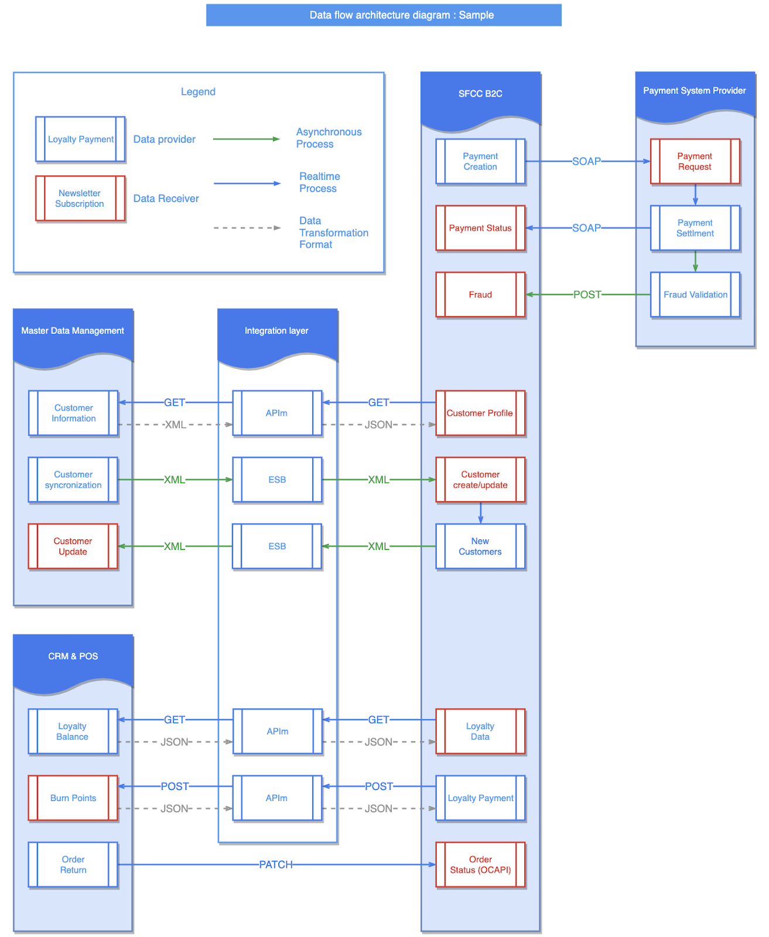
ARCHITECTURE DIAGRAM
architecture diagrams should ideally contain all the systems that are part of your e-commerce project highlighting the connections between systems

Slide 7
MODULE DESCRIPTION
Modular commerce divides the backend components into individual modules. Each is responsible for a single service. Breaking each area of functionality out into its own module provides more flexibility. It cleans up the codebase and makes it easier to deploy new features.
Cart and checkout
Product information management
Order management
Pricing and promotions engines
Personalization engines
Content management
Analytics

Slide 8
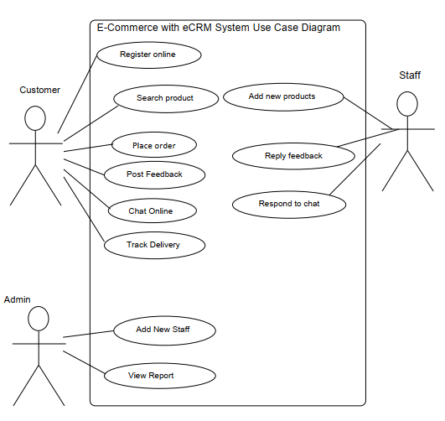
USE CASE DIAGRAM

Slide 9
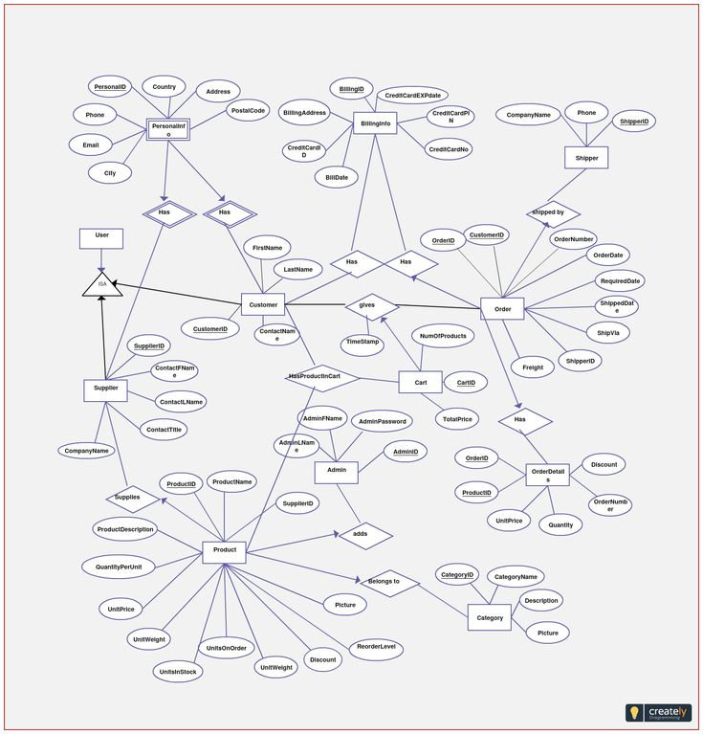
ER DIAGRAM

Slide 10
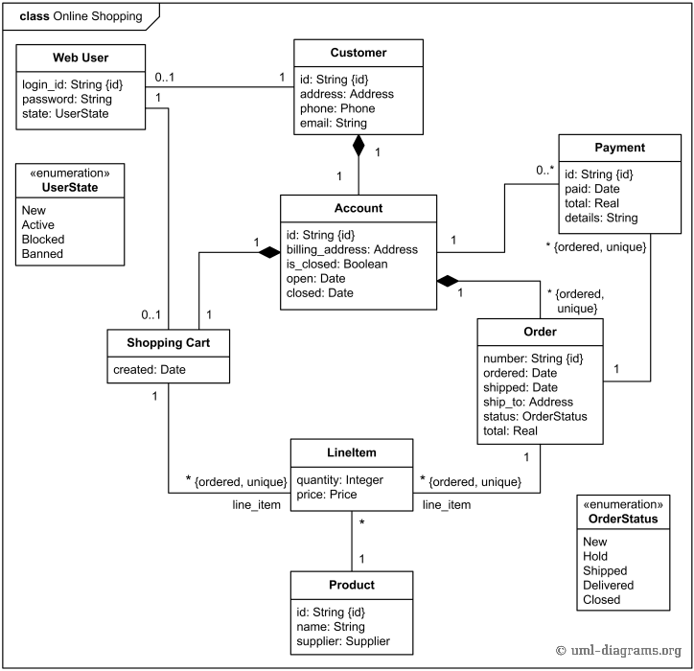
CLASS DIAGRAM

Slide 11
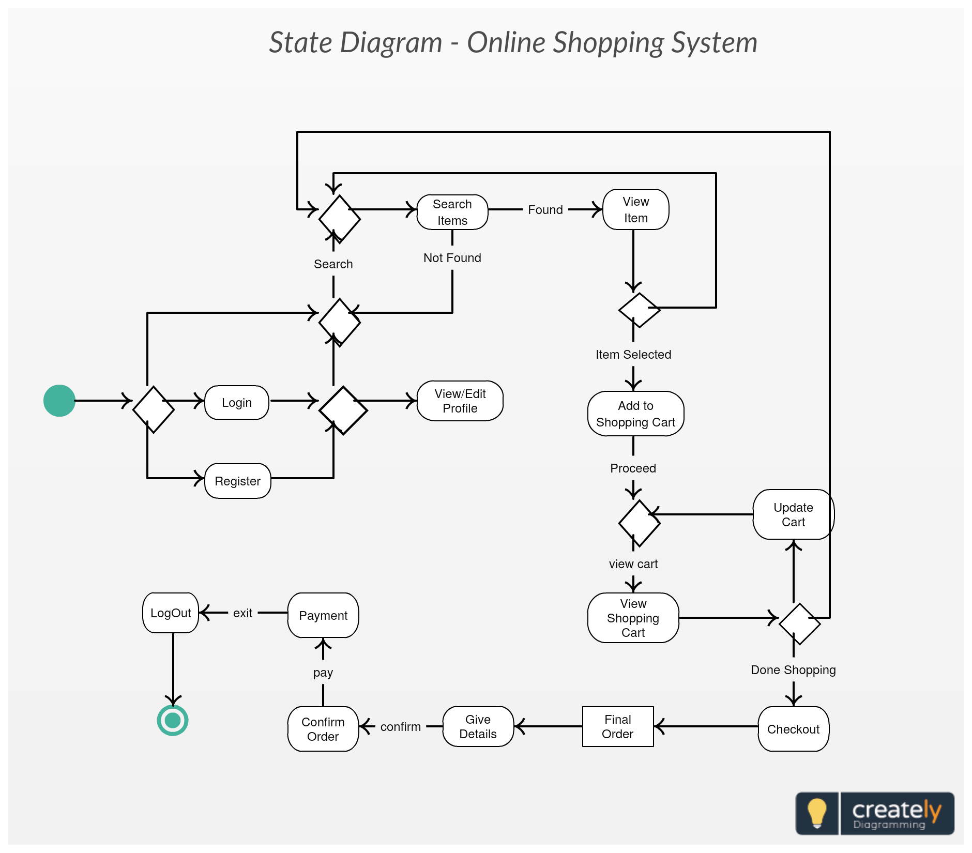
STATE CHART DIAGRAM

Slide 12
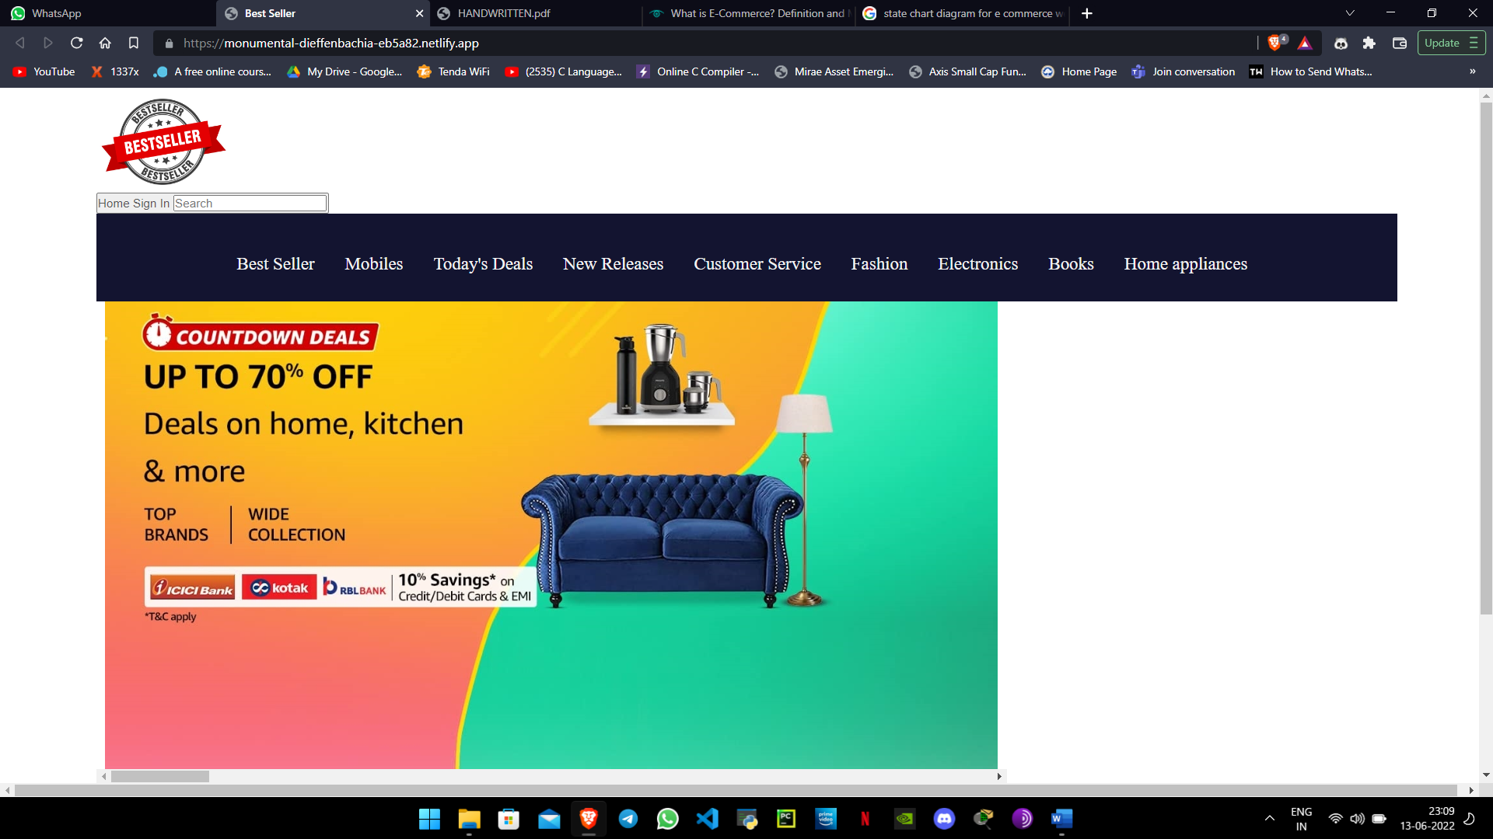
DEMO

Slide 13
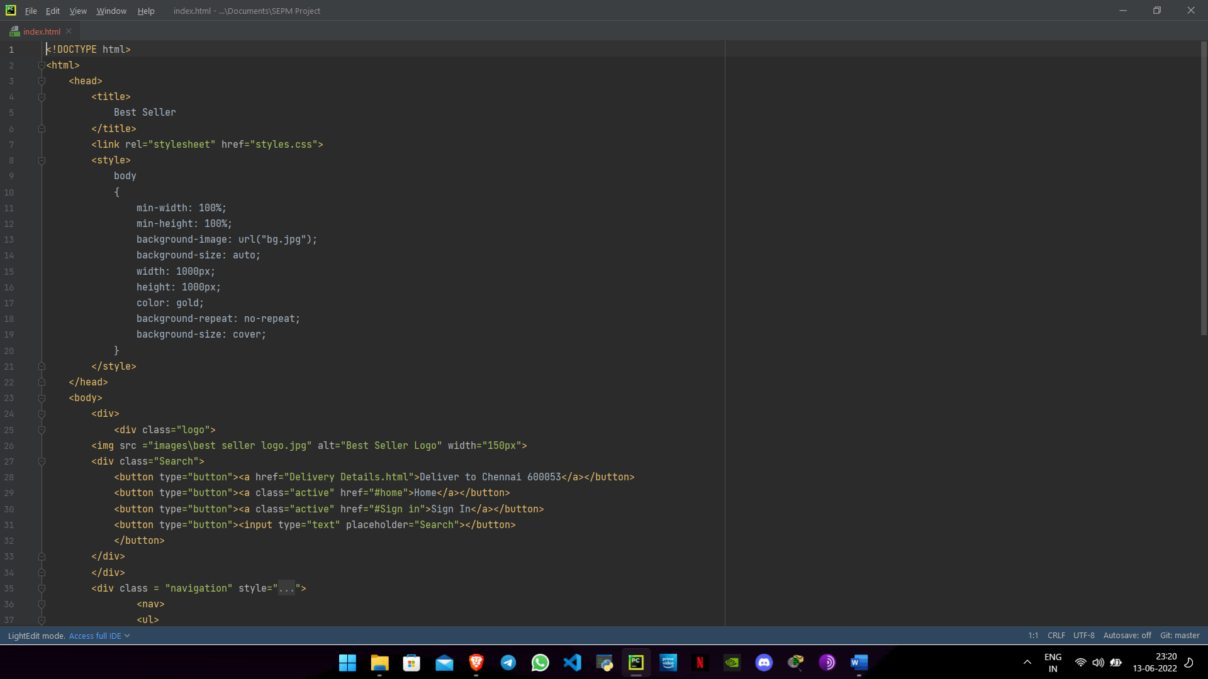
CODE

Slide 14
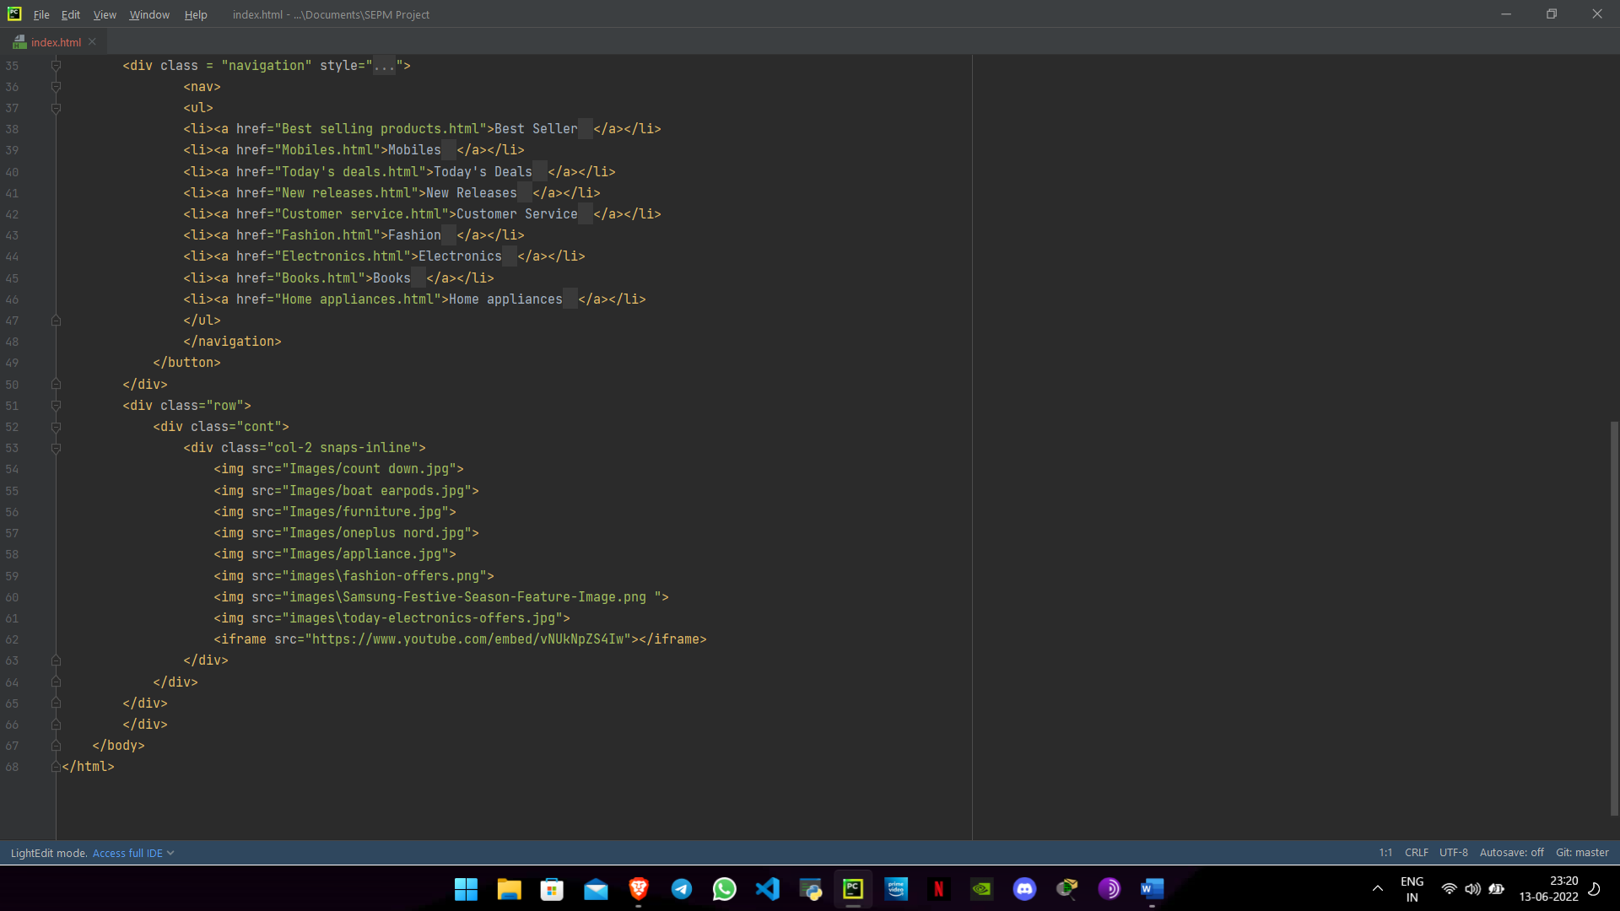

Slide 15
CONCLUSION
The entire project has been developed and deployed as per the requirements stated by the user. It is found to be bug free as per the testing standards that are implemented. The whole system's activities divided are into three major parts like trending products and Wishlist. For implementing the system VSCode is used.
The system analysis was composed of two activities, requirement determination and structuring. The first activity focused on the collection of data or requirements through structured interview, work environment observation and by collecting procedures and other written documents.
And the latter, performed the modelling of the collected data and processes, transforming it into UML diagrams with the aid of a UML modelling tool. Structured analysis uses DFDs (Data Flow Diagrams) to model data and processes, systems analysts use UML to describe Object Oriented systems, on which the current system is based.
UML is independent of any specific programming language and can be used to describe business processes and requirements generally. Finally, the implementation or coding of the proposed system was based on the software architecture standard, using HTML, CSS, Javascript programming languages, which is based on the object-oriented paradigm.
Finally, we like to conclude that we put all our efforts throughout the development of our project and tried to fulfill most of the requirements of the user.

